Slide 1

Neuromorphic engineering: computational neuroengineering module
Mazzoni@Bionics 2025-2026

Slide 2
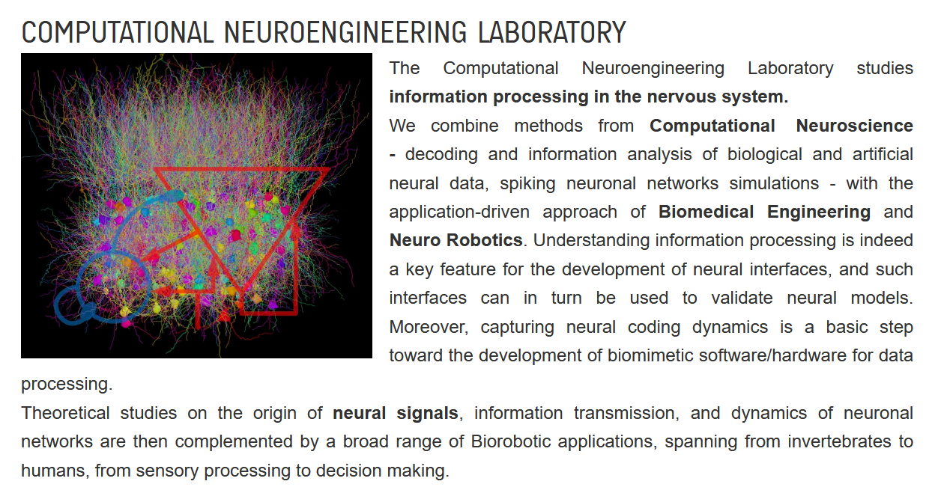



Slide 3
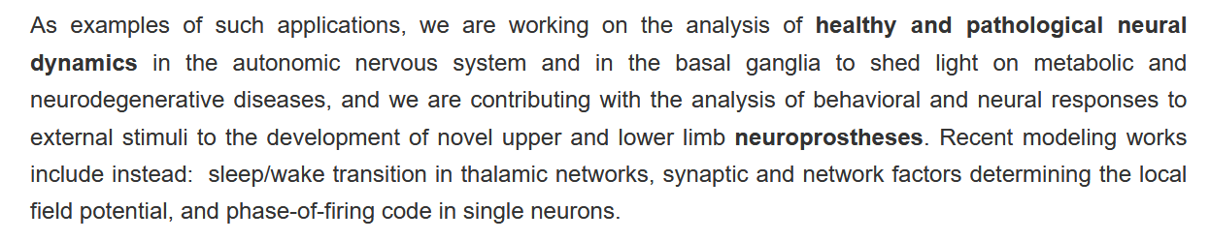
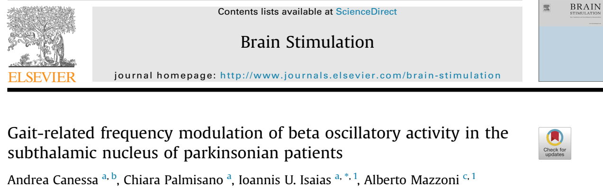
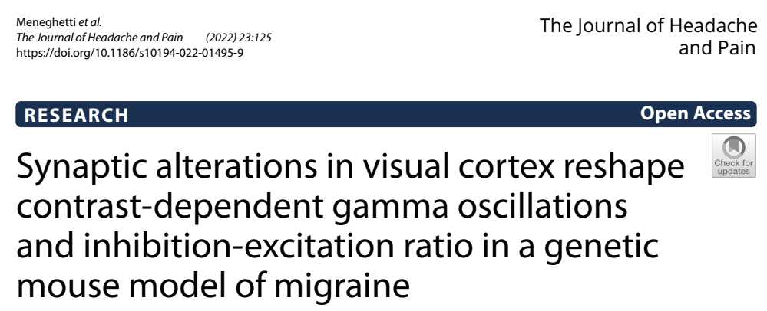

Slide 4


Slide 5

Neural Coding

Slide 6
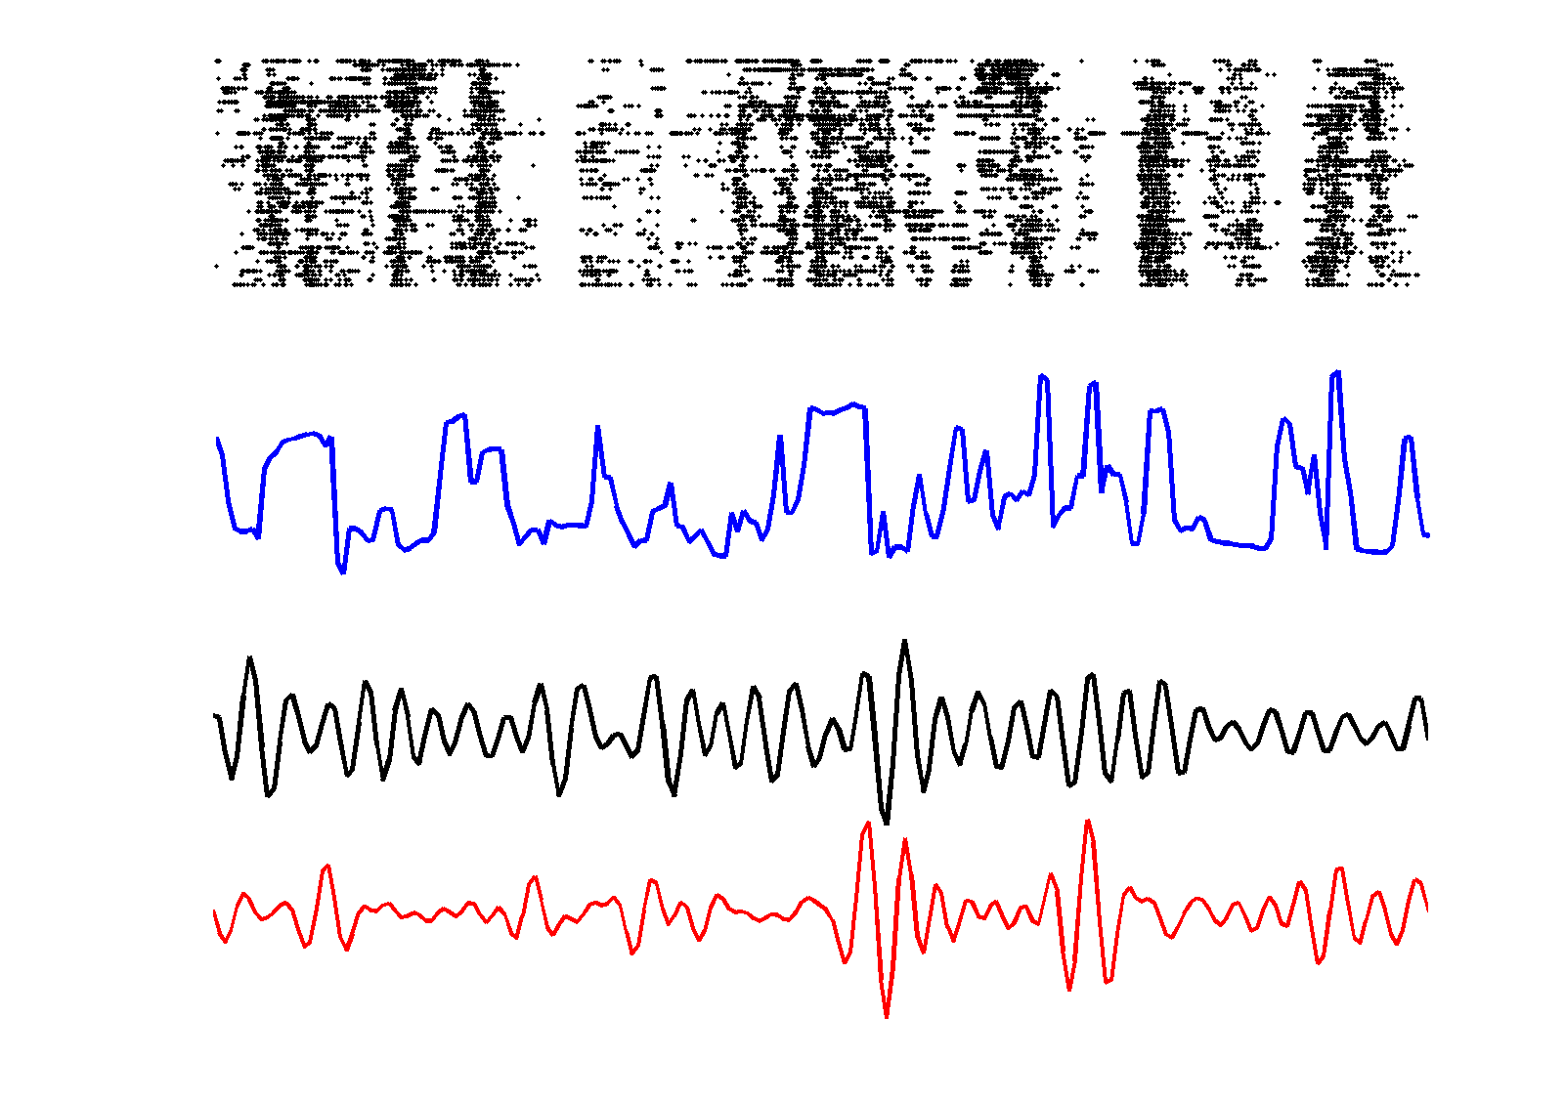
Neural Coding

Slide 7
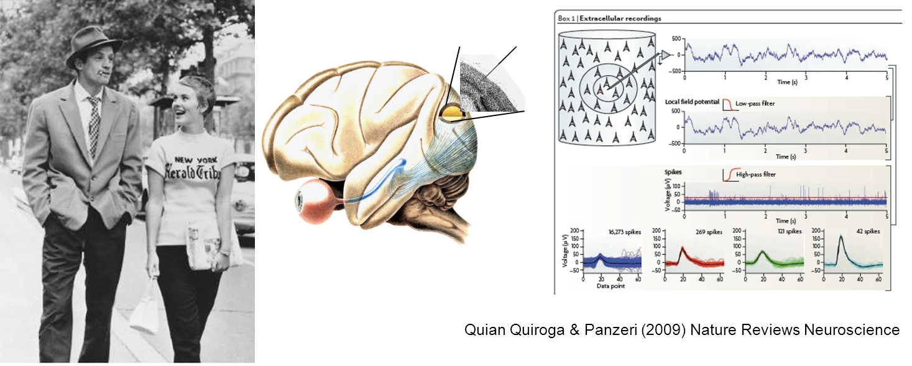
Neuronal Coding
How do neurons encode and transmit sensory and motor information?
What is the language (“code”) used by the neurons to transmit information to one another?

Slide 8
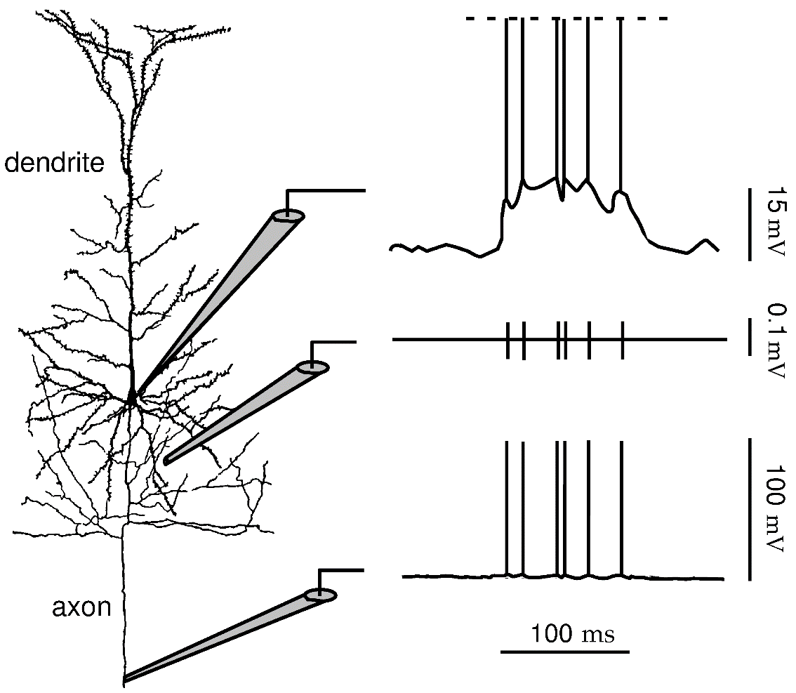
The neuronal code is a sequence of spikes
Somatic electrode – subthreshold membrane potential plus Action Potentials (spikes)
Extracellular electrode
Axonal electrode– subthreshold membrane potential are attenuated and only spikes propagate long distance

Slide 9
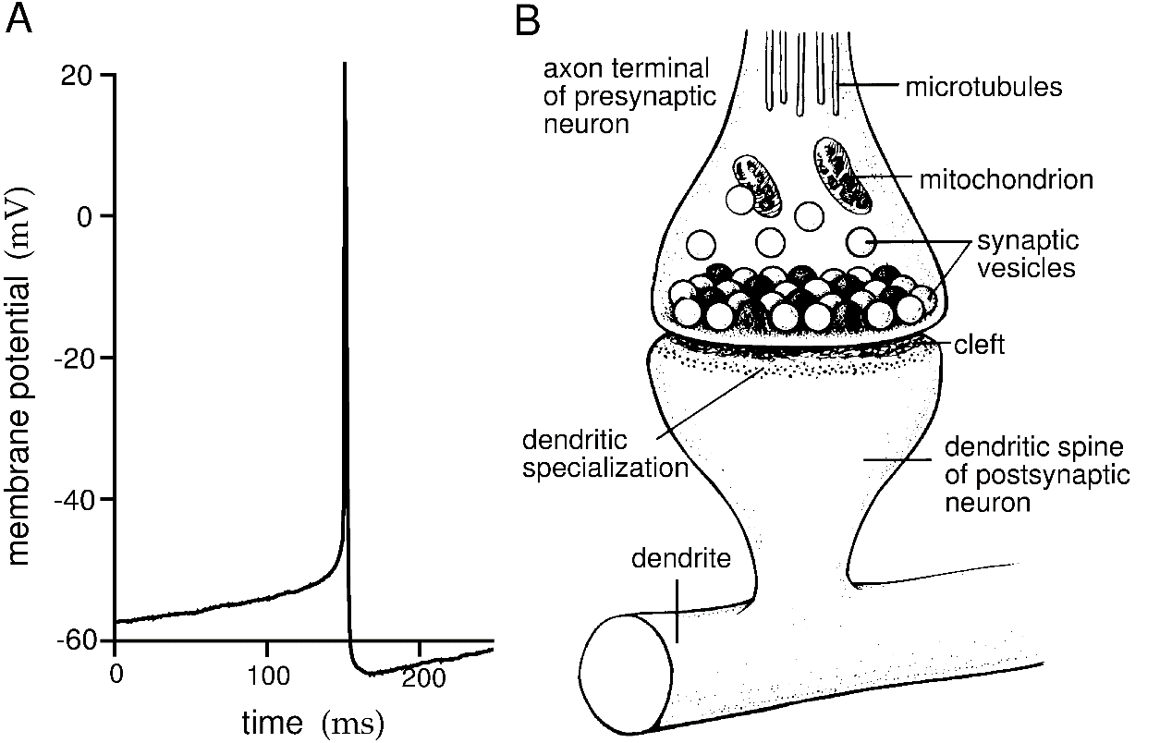
The synaptic vesicles in the axon terminal release neurotransmitters only when an action potential arrives from the presynaptic neuron
Thus, neurons communicate information only through action potentials, not through subthreshold membrane fluctuations.
Thus, the neuronal code consists of a time series of stereotyped action potentials
The neuronal code is a sequence of spikes

Slide 10

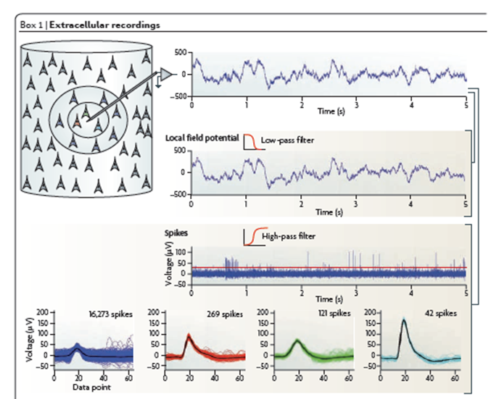
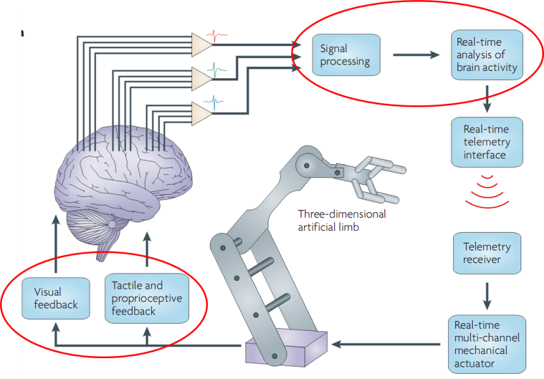
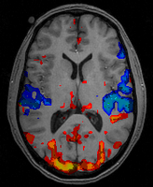
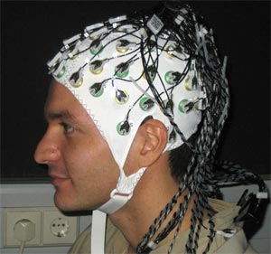
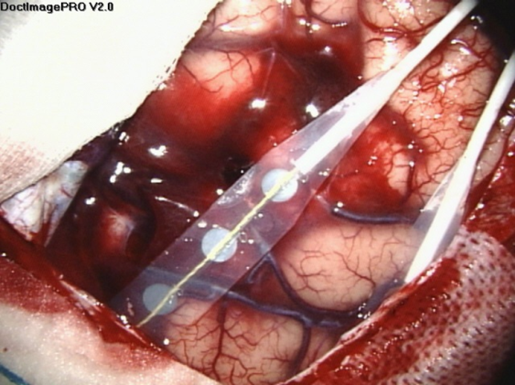
… but on our perspective, the code is
LFP
spikes
fMRI
ECoG
EEG

Slide 11
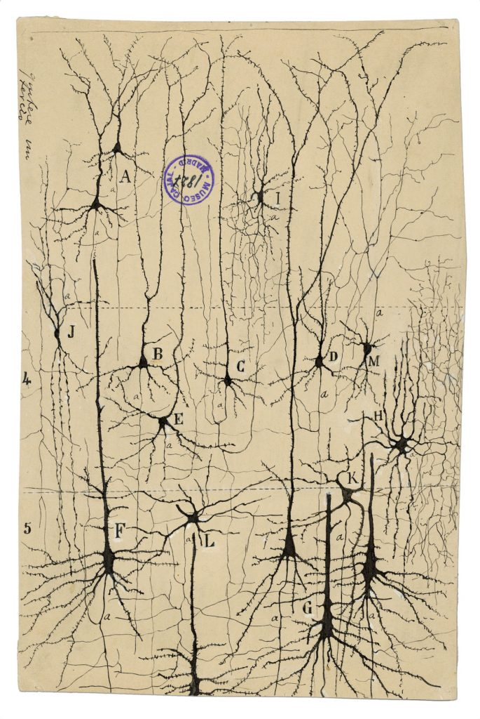
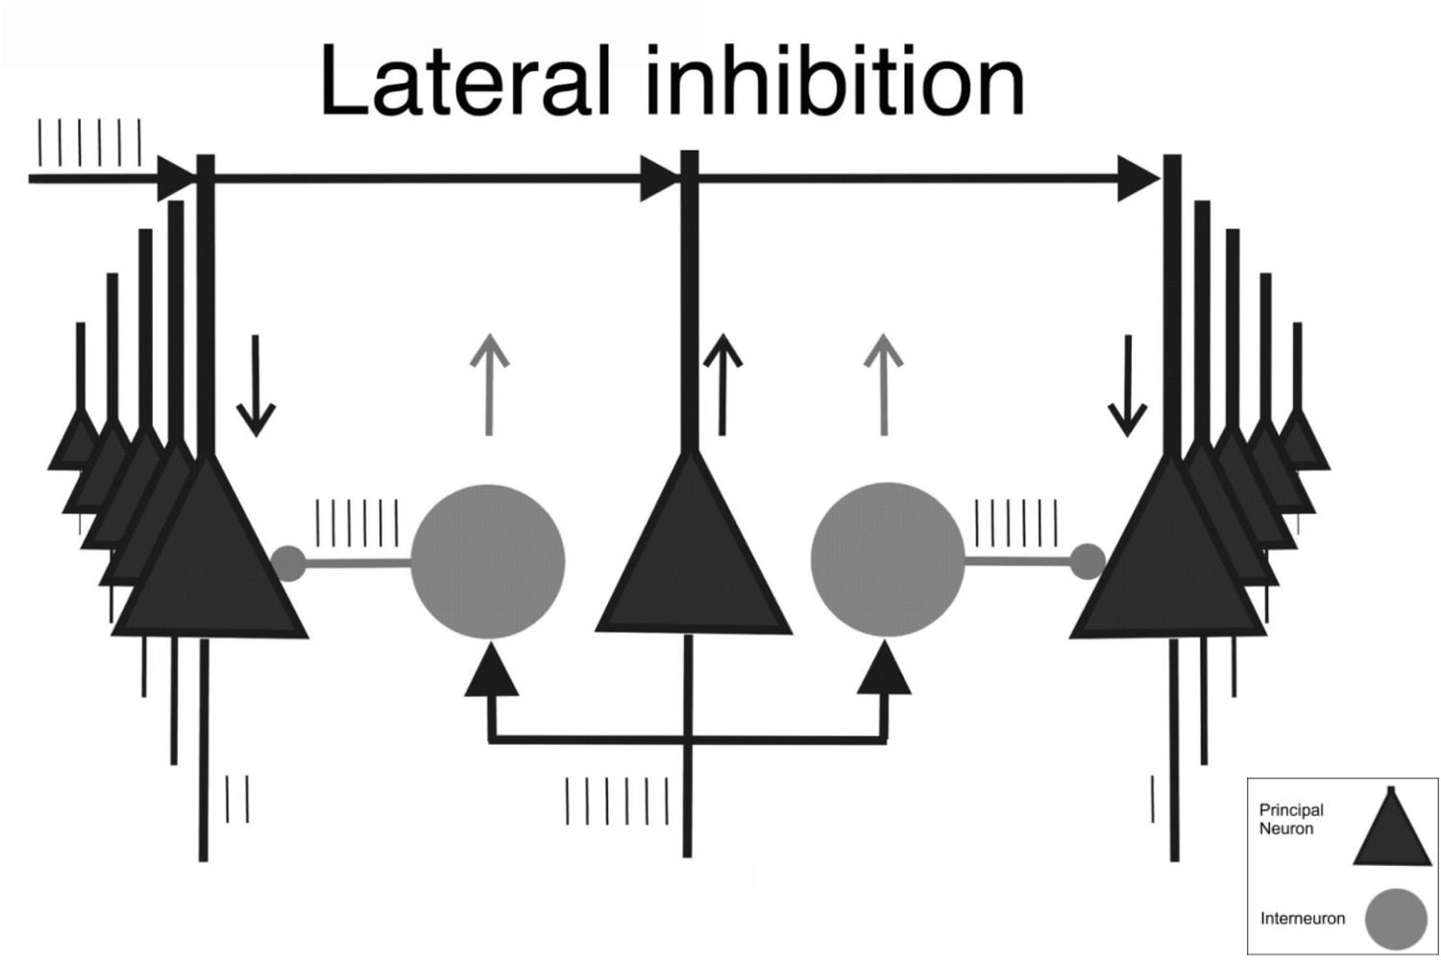
Neurons act in networks

Slide 12
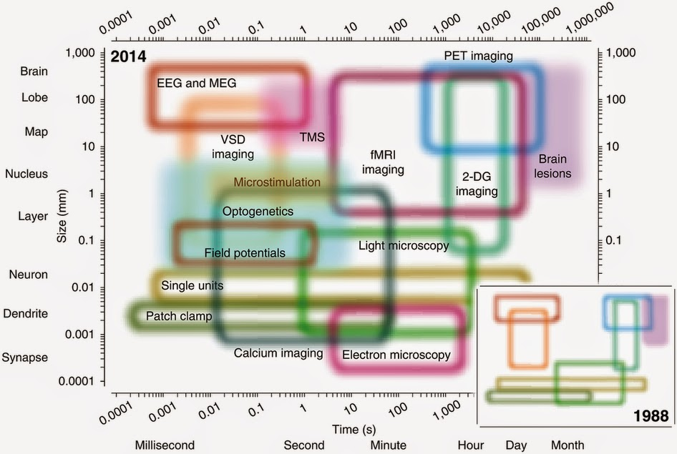

Slide 13
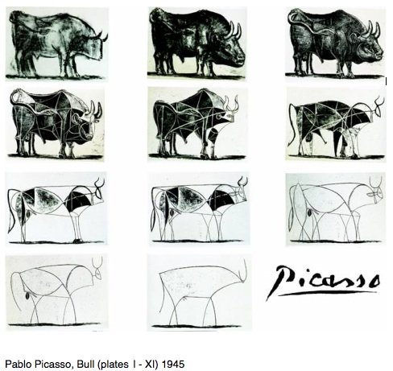
How do we know what we know

Slide 14

Neuronal Models

Slide 15

Why should I model neurons?
1) To get
ONE BILLION EUROS
From the European Community
https://www.humanbrainproject.eu

Slide 16

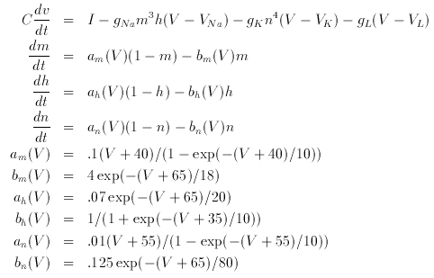

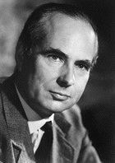
Why should I model neurons?
2) To win the Nobel prize
Hodgkin
Hodgkin and Huxley equations describing single neuron dynamics
Tested on giant squid axon
Huxley

Slide 17
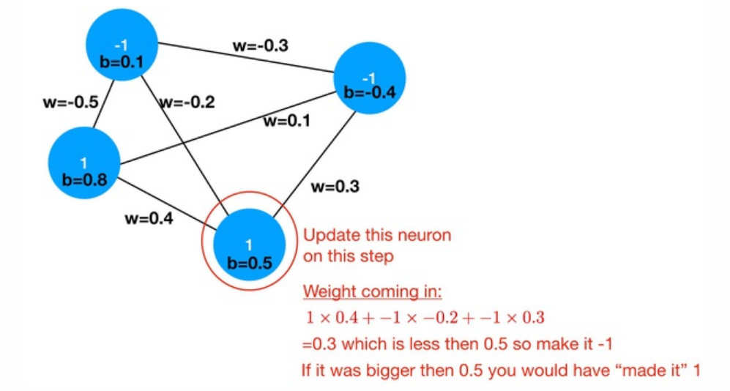

Why should I model neurons?
2) To win the Nobel prize IN PHYSICS

Slide 18

Why should I model neurons?
2) To win the Nobel prize IN PHYSICS

Slide 19

Why should I model neurons?
3) To become the best neuroengineer in the room

Slide 20

William of Ockham (c. 1287–1347)
entia non sunt multiplicanda praeter necessitatem
among all the models explaining the phenomenon under investigation, always choose the simplest

Slide 21
The simplest model
Observation: neurons communicate throug discrete events.
Each cell is a neuron: black active, white inactive.
Whenever a cell turns black (from inactive to active), triggers on average N neighbors

Slide 22
Simple model, complex consequences
Condition 1: N<1 – Inhibition dominating
Finite size, finite duration events
No communication is possible between different areas.
Band-limited power spectrum

Slide 23
Simple model, complex consequences
Condition 2: N>1 – Excitation dominating
Any stimulation ends with the whole network active (epilepsy)
Again no communication is possible
Bimodal power spectrum (no events AUT strong events)

Slide 24
Simple model, complex consequences
Condition 3: N=1 – Excitation-Inhibition balance
Virtually endless possible patterns
Optimal communication
Power law power spectrum (no characteristic timescale/size)

Slide 25
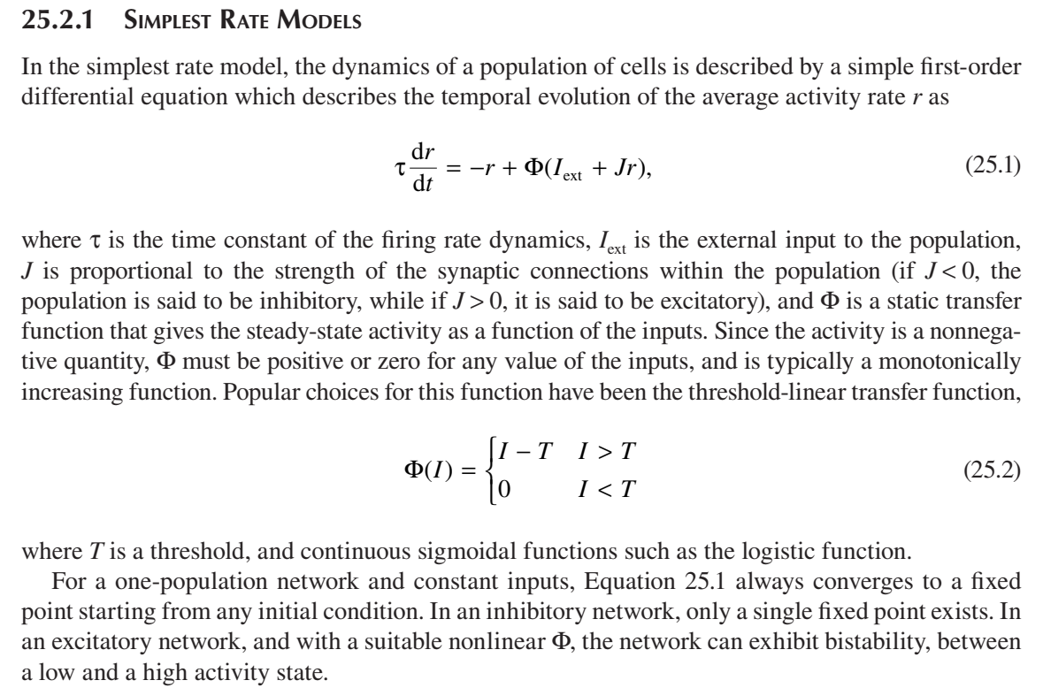
Introducing time: rate models

Slide 26
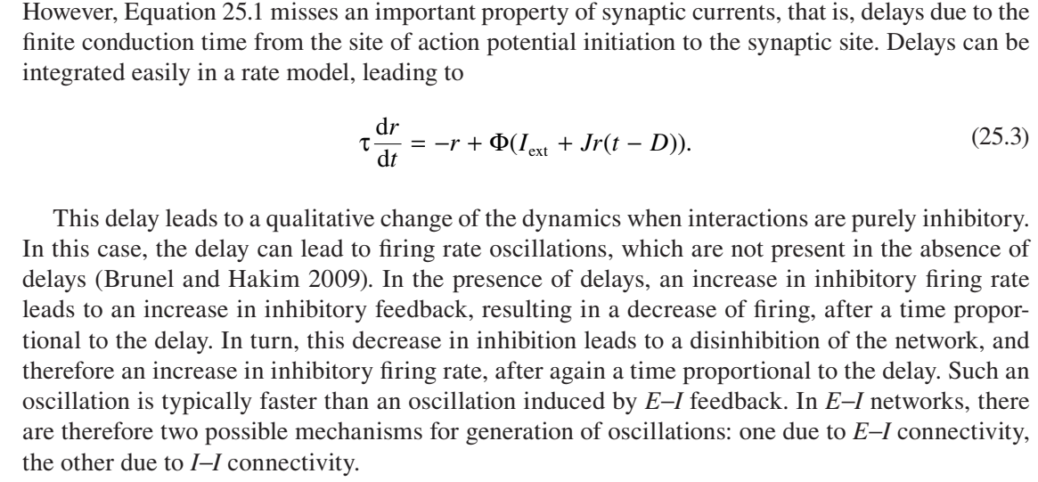
Introducing time: rate models

Slide 27
Introducing potential: the integrate and fire neuron
Spike
Threshold potential
Excitatory input
Reset
Excitatory input
Excitatory input
Membrane
potential
Time

Slide 28
Introducing potential: the integrate and fire neuron
Spike
Threshold potential
Excitatory input
This model is much simpler than HH since it does NOT simulate active sodium and potassium channels originating the action potential.
Reset
Excitatory input
Excitatory input
Membrane
potential
Time

Slide 29
Introducing inhibitory inputs the integrate and fire neuron
Spike
Threshold potential
Excitatory input
Reset
Inhibitory input
Inhibitory input
Excitatory input
Membrane
potential
Time

Slide 30
Introducing resting potential: the LEAKY integrate and fire neuron
Spike
Threshold potential
Excitatory input
Reset
Excitatory input
Comes back to resting
Excitatory input
Inhibitory input
Comes back to resting
Membrane
potential
Time

Slide 31
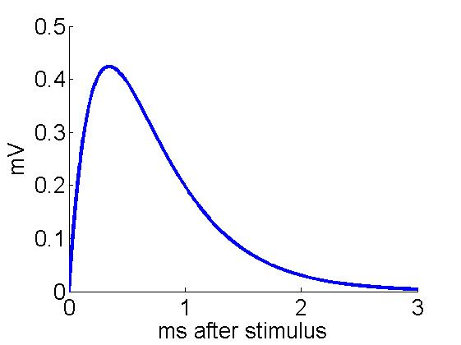
Leaky integrate-and-fire neuron
Only Excitatory and Inhibitory
synapses
Subthreshold:
Synaptic dynamics:
J
τr
τd
If
a spike is emitted
Vk drops to Vres
the neuron can not fire for a time τref
S
Other possibilities: NMDA synapses

Slide 32

Leaky integrate-and-fire neuron
Only Excitatory and Inhibitory
synapses
Subthreshold:
Synaptic dynamics:
$τ_{m}$= relaxation time of membrane potential (usually 20 ms or so, depends on the size of the soma)
Reset potential is set at 0 mV
$V_{A}$ indicates AMPA (excitatory) post-synaptic potentials (PSP)
$V_{G}$ indicates GABA (inhibitory) post-synaptic potentials (PSP)
J
τr
τd
If
a spike is emitted
Vk drops to Vres
the neuron can not fire for a time τref
S
Other possibilities: NMDA synapses

Slide 33

Leaky integrate-and-fire neuron
$τ_{r}$ indicates rise time of the PSP (1-5 ms usually) due to channel opening
$τ_{d}$indicates decay time of the PSP (3-10 ms usually) due to channel closing
$S_{k}^{stim}$ is 0 except when the neuron is receiving an input
$J_{k}^{stim}$ is the strength of the input
Only Excitatory and Inhibitory
synapses
Subthreshold:
Synaptic dynamics:
J
τr
τd
If
a spike is emitted
Vk drops to Vres
the neuron can not fire for a time τref
S
Other possibilities: NMDA synapses

Slide 34
Leaky integrate-and-fire neuron
Only Excitatory and Inhibitory
synapses
Subthreshold:
The solution of the coupled differential equation is a difference of exponential following the onset of each stimulus, with amplitude J.
Synaptic dynamics:
J
τr
τd
If
a spike is emitted
Vk drops to Vres
the neuron can not fire for a time τref
S
Other possibilities: NMDA synapses

